Slide 1
DETECTING FRAUDULENT BEHAVIOUR IN ONLINE NETWORK
Presented By :-
Tanushree Sarkar(23352079)
Soumitra Halder(23352112)
Rohit Konar(23352059)

Slide 2
Introduction
As online networks grow, so do risks of fraud, including identity theft and fake accounts. Traditional detection methods are often inadequate against evolving tactics. Our project uses machine learning (K-Means clustering) and network analysis to detect unusual patterns in user behavior, enabling early identification of potential fraud in online interactions.

Slide 3
Problem Statement
Detecting fraud in complex online networks is challenging, as fraudsters often mimic normal user behavior to evade detection. Traditional methods fall short against these tactics. Our project leverages unsupervised machine learning (K-Means clustering) and network analysis to uncover suspicious patterns, identifying potential fraud without predefined rules.

Slide 4
Objective
Detect Suspicious Activity: Identify potential fraud through network and behavior analysis.
Anomaly Detection: Classify users with K-Means clustering to spot deviations.
Graph Features: Use connectivity and centrality metrics for accurate classification.
Visualization & Reporting: Offer clear visuals and reports for decision-making.

Slide 5
Approach
1. Anomaly Detection with K-Means Clustering
Objective: Detect unusual user behavior by clustering network activity.
K-Means Process:
Set number of clusters (k)
Initialize centroids
Assign data points to nearest centroid
Update centroids until stable clusters form
Implementation:
Data preparation (remove irrelevant data, standardize features)
Use Elbow Method to choose optimal clusters
Cluster users and flag outliers as potential fraud based on behavior deviations .

Slide 6
Approach
2. Classification of Fraudulent Users
Post-Clustering Classification:
Distinguish user types:
-Legitimate Users: Show typical behavior patterns within clusters.
-Fraudulent Users: Identified as outliers with unusual behaviors or network properties, flagged for further review.

Slide 7
Data Set
We created a synthetic dataset simulating user behavior in an online network to explore both legitimate and fraudulent activities.
Key Features:
User ID: Unique identifier
Friends Count: Number of friends
Groups Joined: Number of groups
Posts Per Week: Average posts
Likes Received: Total likes
Messages Sent: Total messages
Login Frequency: Logins per week
Time Between Interactions: Time between activities
Dataset Characteristics:
Includes a mix of legitimate and fraudulent behaviors, crucial for training fraud detection models.
Fraudulent Patterns: Fewer connections, high messaging volume, unusual posting frequency, and spam-like behavior.
Dataset Link -> https://drive.google.com/file/d/1WGMIHdqAEfjI--Ky-hKgfrncg1FTCydw/view?usp=sharing

Slide 8
System Design
Collect Data
Data Preprocessing
Anomaly Detection (K-Means Clustering
Suspicious User Identification
Store The Result

Slide 9
Implementation
1. Setup & Data Loading:
Import necessary libraries (`pandas`, `google.colab.files`).
Load dataset (`data7.csv`) into a DataFrame using `pd.read_csv()`.
2. Data Preprocessing:
Drop unnecessary columns (e.g., `User ID`) and standardize the features with `StandardScaler`.
3. Data Visualization:
Use `seaborn` and `matplotlib` to create a pair plot for visualizing feature relationships.
4. K-Means Clustering:
Apply K-Means clustering to identify distinct clusters.
Use the Elbow Method to determine the optimal number of clusters.
Fit the model with `n_clusters=2` and predict cluster labels.

Slide 10
Implementation
5. Identify Suspicious Patterns:
Define criteria (e.g., fewer than 100 friends, more than 500 messages) to flag suspicious clusters.
6. Filter Suspicious Users:
Filter and display users in suspicious clusters for further review.
7. Visualization & Results:
Visualize clusters using a pair plot.
Save results as `clusters.csv` and provide download link.

Slide 11
Result
Code & Result Link-
https://colab.research.google.com/drive/1vgPfjAyvdhTRM4QE0iU479IuUvCr_xSC?usp=sharing

Slide 12
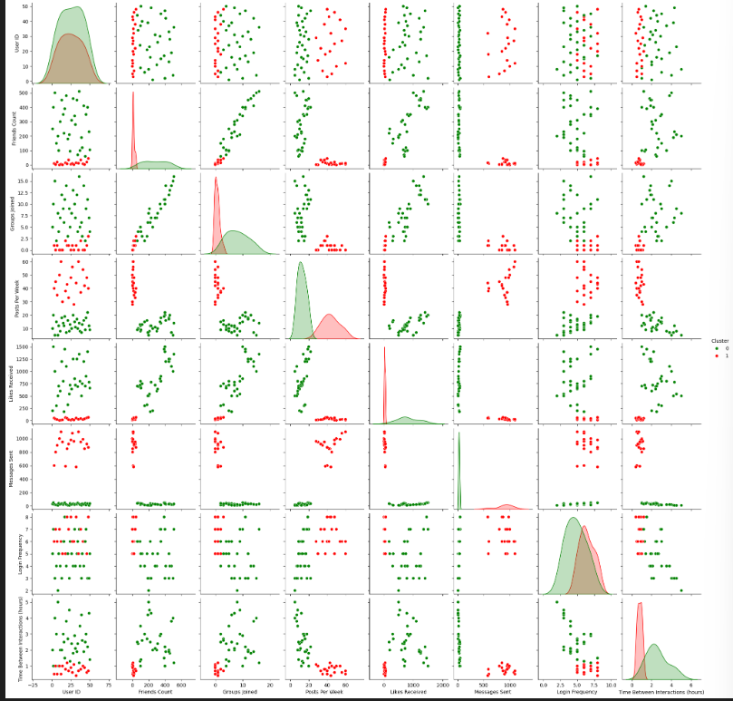

Slide 13
Additional Implementation
Code & Result Link-
https://colab.research.google.com/drive/1fpVF4j5PNjaAKtKvaNKNCtwSGSTT2Jio?usp=sharing

Slide 14
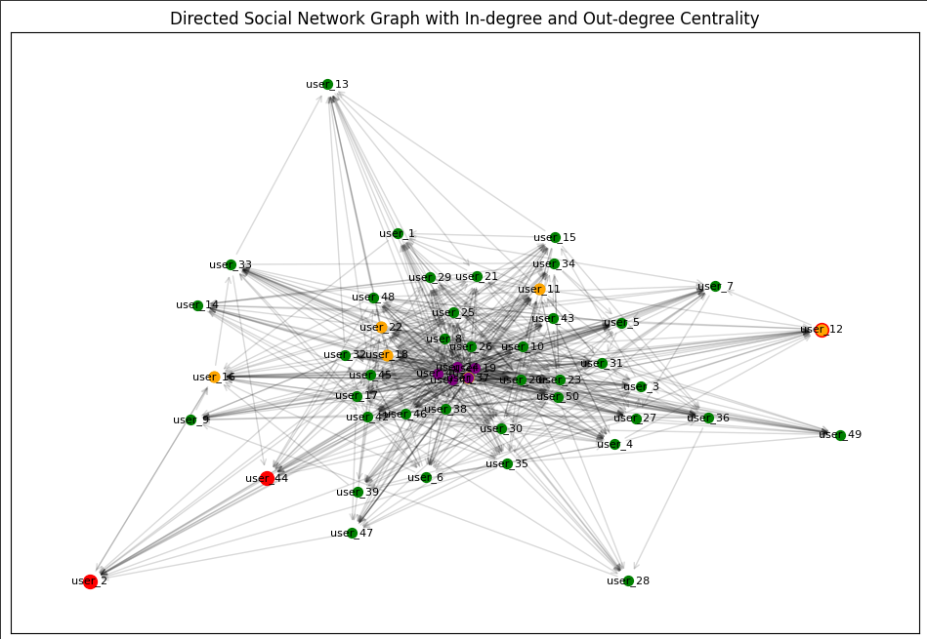

Slide 15
Conclusion
This project used K-Means clustering to detect fraudulent users in online networks by analyzing interaction patterns. Suspicious users were identified based on behaviors like fewer friends and more messages, with an additional analysis of degree centrality. The system demonstrates how machine learning can enhance online security by proactively spotting fraud and maintaining platform integrity.

Slide 16
Thank You

